Slide 1
Becoming God’s Friend
Romans 11:33-12:3
Notes:
“FRIEND” = VERY Strange View of G
Cf. World Relig→ “Force” / “Sovereign..Almighty”
OR: “Spirit Guide” (~God)
OR: “The Big Question” = ???

Slide 2
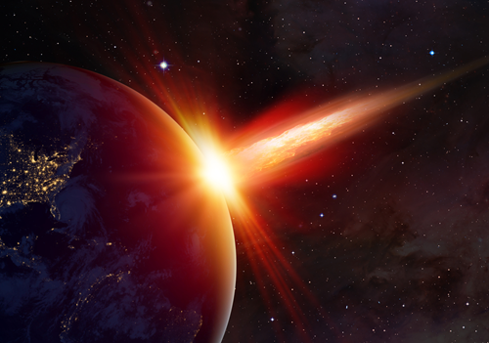
Some of God’s Friends…
Romans 10:12-13 For there is no difference between Jew and Gentile--the same Lord is Lord of all and richly blesses all who call on him, for, "Everyone who calls on the name of the Lord will be saved."
Romans 9:8 ”…children of the promise who are regarded as Abraham's offspring.”
James 2:23 …Abraham trusted God, and it was credited to him as righteousness,
and he was called God's friend.
Notes:
#1=Abraham Ro.9 → “Children of Israel” → 4k Yrs
**=HUGE Impact → 2 Day = REELING → JEWS
**Jas. 2 → “Righteousness” = G’s Barrier → **“Friend”
“Trusted” = R Barrier/R Decis:→Removd G’s Barrier
= “SAVED”
**Ro.10:12 = Available 2 EVERYONE → “Calls..Saved”
→ U/I = “Called…Friend” → = Honor/Privil/Joy/Amaz!!

Slide 3
Some of God’s Friends…
Romans 9:15 He says to Moses, "I will have mercy on whom I have mercy, and I will have compassion on whom I have compassion."
Exodus 33:11 The Lord would speak to Moses face to face,
as a man speaks with his friend.
Notes:
#2: Moses → Ro.9:15 = Arbitrary G?? NO!!
=Describing G’s FRIEND→ **Ex.33 = **FRIEND
9:15=G’s Free Will, “with…friend” → NOT: “G=Arbitrary”
AP →Why Some ~Hv Mny Friends
IL: Parents=Hv. 2Luv U→ Friends=Free Will

Slide 4
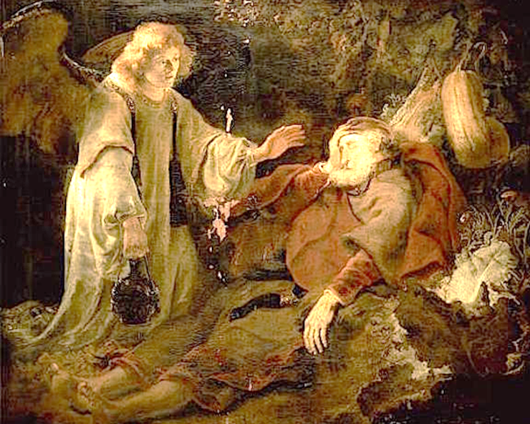
Some of God’s Friends…
Romans 11:2 Don't you know what the Scripture says in the passage about Elijah--how he appealed to God…
Elijah the “Tishbite”
1 Kings 19:5 He lay down and slept under a juniper tree; and suddenly, there was an angel touching him, and he said, "Arise, eat."
Notes:
#3 Elijah= “Talked w/ G…” = Friend 2!
**Ref. 2 1Ki.19 → G=Sent “Angel Food Cake”
=Cool Story→ G=Cool Friend 2 Have
** “TISHBITE” = “Stranger” → ?? IS HE ??

Slide 5
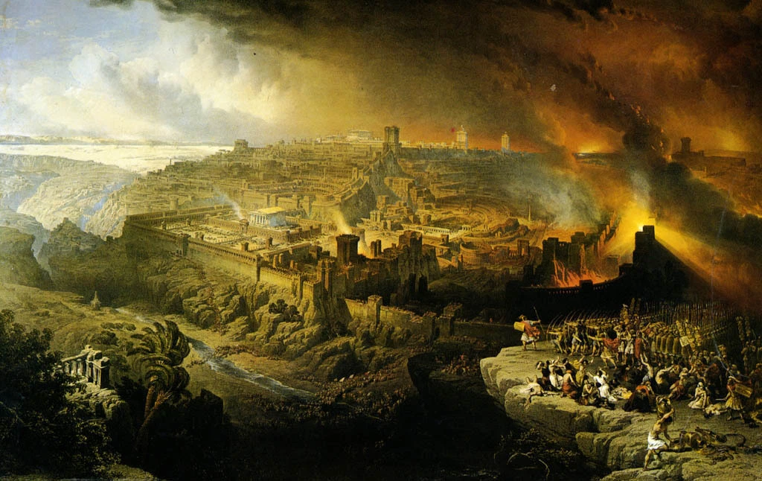
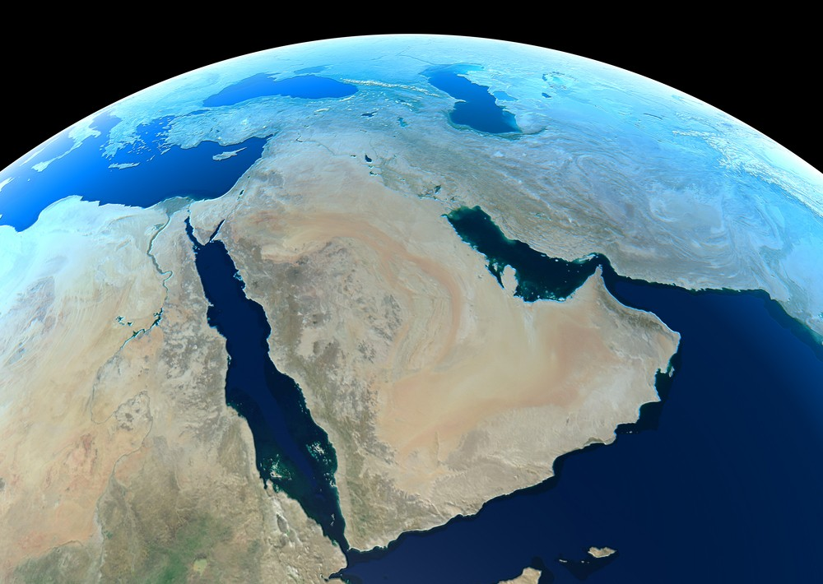
God: from History to NOW
Romans 11:33 Oh, the depth of the riches of the wisdom and knowledge of God! How unsearchable his judgments, and his paths beyond tracing!
Zechariah 12:2 “Look! I am going to make Jerusalem a cup that causes drunken reeling to all the peoples around…”
Notes:
Ch.9-11 = “G. of History” = **Israel → SPEC!!
G=Wraps Human Hist. around His Little Finger
**Zech.12 → 2Day: Nations=DRUNK Ovr. Jerus
Stumbling/Fumbling/Tripping/Tumbling Ovr Israel
Proph=5th C BC → **??Poss. After 70 AD??

Slide 6
God: from History to NOW
Romans 11:34 For who has known the mind of the lord, or who became his counselor?
1 Corinthians 2:16 For who has known the mind of the Lord, that he will instruct him?
But we have the mind of Christ.
Psalm 8:4-5 What is man that You take thought of him?
…Yet, You crown him with glory and majesty!
Psalm 139:14 I will give thanks to You, for I am fearfully and wonderfully made; Wonderful are Your works, And my soul knows it very well.
Genesis 1:26 Then God said, "Let Us make man in Our image, according to Our likeness; and let them rule over…the earth."
Notes:
Ro.11:34 → Luk @Hist → G= ~in R League!!
**=1Co.2:16 Same ?? → **Answ= “WE KNOW!”
**Ps.8=SAME ?? → **=SAME Answ
“Glory” = SIGNIF = Life’s QUEST
**Ps.120 → “Soul Knows…” = Life’s BURDEN
**Gen.1:26=SAME → “Rule” = SIGNIF.
The Point→ G+Humans=Basis 4 RELAT.
The Quest→ “??Kind of Relat??”

Slide 7

What Kind of Relationship?
Romans 11:35 "Who has ever given to God, that God should repay him?"
Romans 11:36 For from Him and through Him and to Him are all things. To him be the glory forever! Amen.
Notes:
Q: “??Kind Relat??” → A: “~BUSINESS Deal”
G: “Pay U Back Nxt WK?”
**Ro.11:36 G=CREATED all/ SUSTAINS/ OWNS all
YET: Manmade Relig=BUSINESS DEAL→MOVIE
Arrogance= “I’ve Got Someth. U NEED, G!”
“If I Do THIS→then U Do THAT!”
=RITUAL WORSHIP “Service” → 1x ^ 2-3x/wk

Slide 8
God’s Reasonable Relationship:
Romans 12:1 Therefore I urge you, brethren, by the mercies of God, to present your bodies a living and holy sacrifice, acceptable to God, which is your spiritual service of worship.

Slide 9
God’s Reasonable Relationship:
Romans 12:1 Therefore I urge you, brethren, by the mercies of God, to present your bodies a living and holy sacrifice, acceptable to God, which is your spiritual service of worship.
NOT Salvation
The “Kindness” of God: Rom.1-11
Romans 5:5 …because the love of God has been poured out within our hearts through the Holy Spirit who was given to us.
Notes:
“Mercies” = **Kindness → Ro.5:5 = G’s LOVE
i.e., ** ~Salvat → GOSP: U=Nd. 2 “Cry Out…SAVED!”
=Given HS → Will Only Find KINDNESS
THEN: “Therefore…” = Makes Sense

Slide 10
God’s Reasonable Relationship:
Romans 12:1 Therefore I urge you, brethren, by the mercies of God, to present your bodies a living and holy sacrifice, acceptable to God, which is your spiritual service of worship.
NOT Salvation
He wants your permission
NOT Without Struggles!
Jeremiah 20:7 O LORD, You have deceived me and I was deceived; You have overcome me and prevailed. I have become a laughingstock all day long; Everyone mocks me.
“Punctiliar” Past Tense
“Once-for-All Time” Decision
A New Kind of Relationship
Notes:
Aorist = **Punctiliar → ** 1x Decis=Basis 4 **Relat
= **Permiss. → “Will U Trust Me…Direction…Life?”
~Do it 2U→ URGES: Ur Life=SHORT!
** ~w/o Struggles / Lapses / Failures
AP: May Hv 2 REVISIT/Remembr This Decis.
BUT: there IS a FOUNDATION
IL: Marriage w/ Dar → (~Struggle 4 HER)

Slide 11
God’s Reasonable Relationship:
Romans 12:1 Therefore I urge you, brethren, by the mercies of God, to present your bodies a living and holy sacrifice, acceptable to God, which is your spiritual service of worship.
NOT Salvation
He wants your permission
To steer your life
σῶμα
Your whole person
The remainder of your life.
Living / Holy
NOT as a “resigned” defeat
Alive, willing & “it’s cool!”
Notes:
** Soma ** 2 Steer → “Captain of my SOUL”
AP: G=Wants 2 CLOTHE HIMSELF in Ur Body
** “Living/Holy” → ~a TRAPPED Beast
AP: =Why G KEEPS Asking→ “U Sure?”
AP: U Hv 2 Commit 2 Make It Work
~MONASTARY → HEART-Issue
Commit = the JOY of the XIAN Life
AP: G=Knows U→ ~Screw U Ovr!

Slide 12
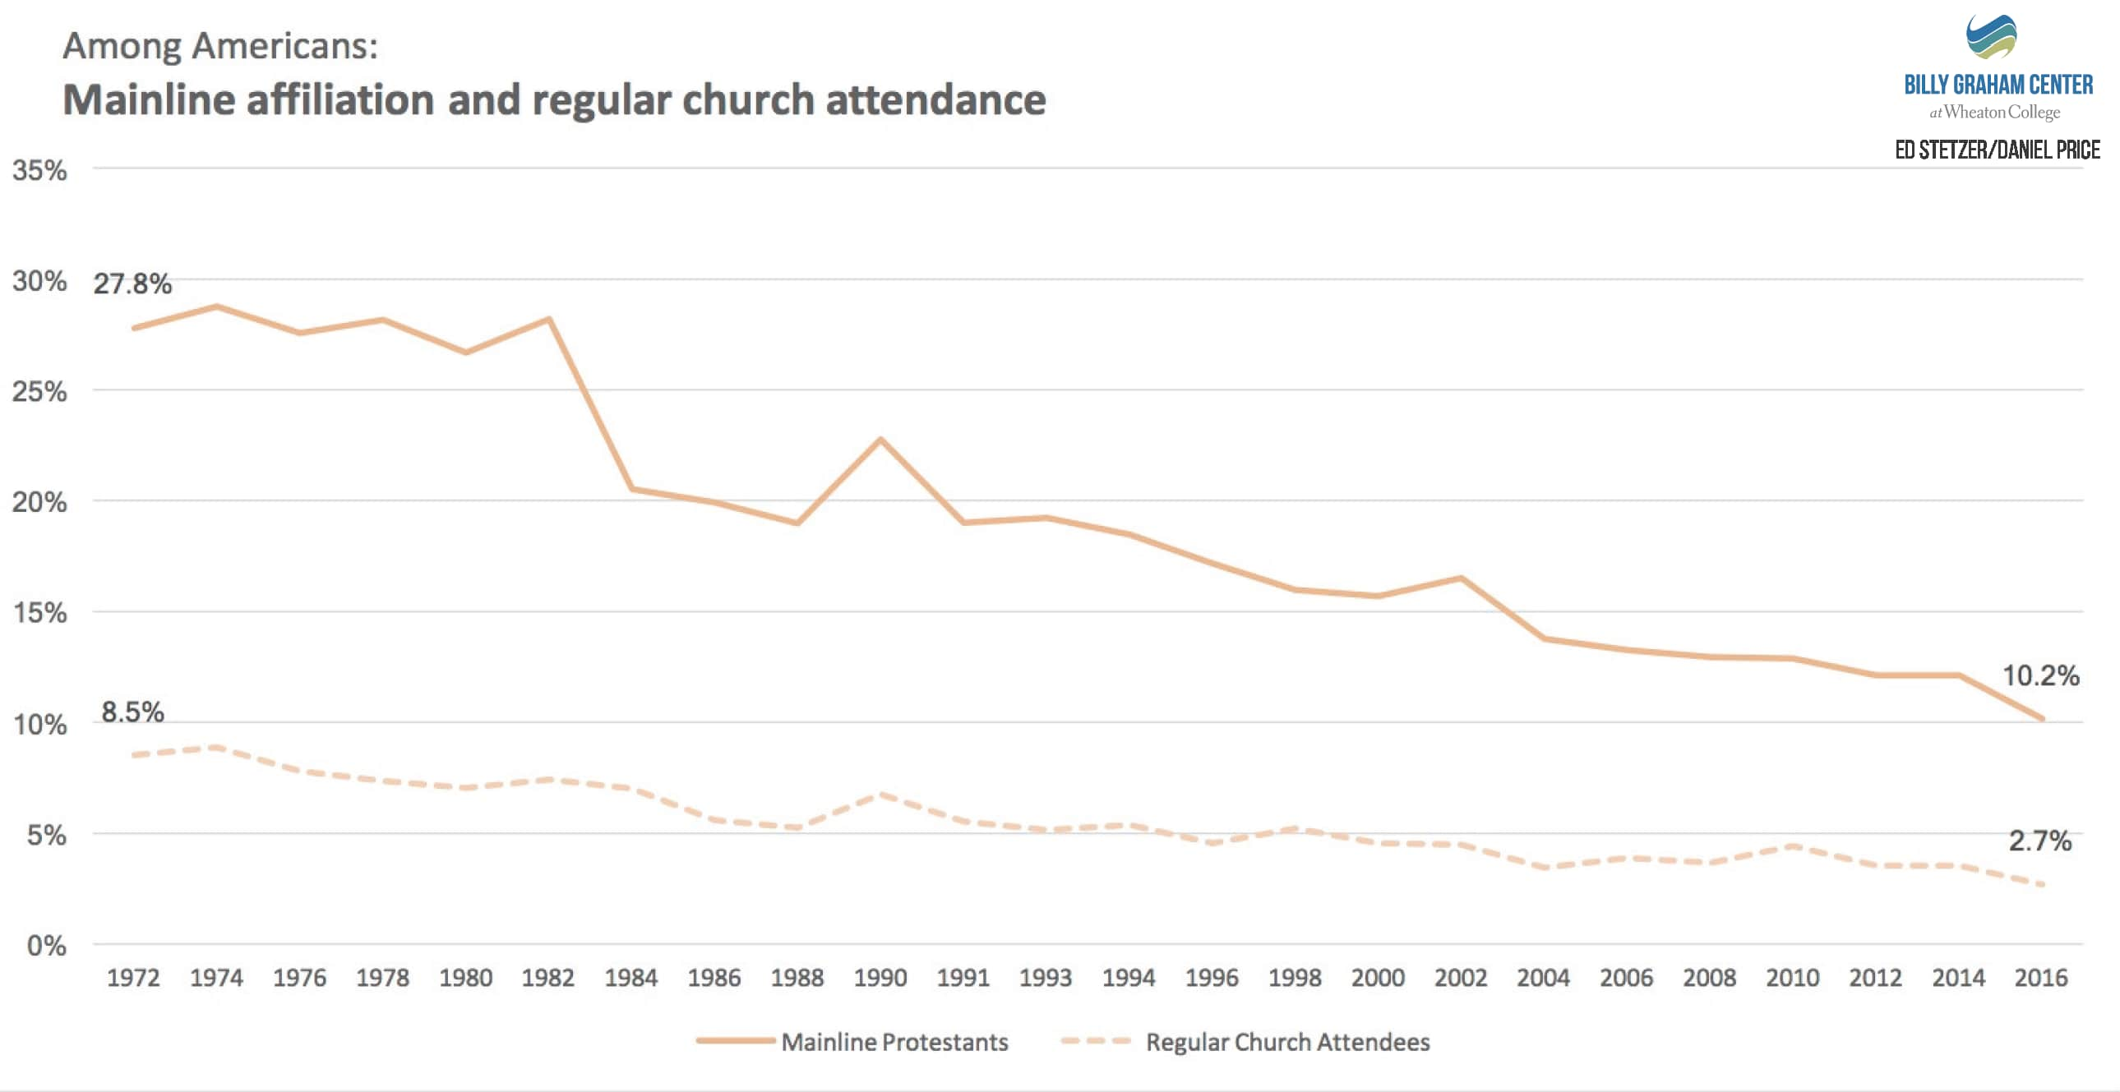

God’s Reasonable Relationship:
Romans 12:1 Therefore I urge you, brethren, by the mercies of God, to present your bodies a living and holy sacrifice, acceptable to God, which is your spiritual service of worship.
NOT Salvation
He wants your permission
To steer your life
Every day, not once-per-week
NOT
“Worship Service”
Notes:
G ~Want **“Worship Service” → ** Every Day
“Singing Worship Service” ~In NT
It’s ~ WRONG → It’s ~Necessary
CERTAINLY: It’s Deceptive 2Day→ Vast $$$
“Acceptable…G” = What PLEASES God!
Worship Serv→ **~WORKING! Esp. w/ Millenials
** Hip/Fog/Lights/Bands/$$$→ Still EMPTYING

Slide 13
God’s Reasonable Relationship:
Romans 12:1 Therefore I urge you, brethren, by the mercies of God, to present your bodies a living and holy sacrifice, acceptable to God, which is your spiritual service of worship.
Self-Directed
Christ-Directed
NOT Salvation
He wants your permission
To steer your life
Every day, not once-per-week
A logical decision
λογικός From λόγος. Pertaining to reason and therefore reasonable, or pertaining to speech as reasonable expression. In Rom. 12:1, the "reasonable service" or worship. Expository Dictionary
Notes:
**Logikos = LOGIC / Logos=“Reason”
~SLOPPY SENTIMENTAL/Emotional Decis
~ “Change…Feelings” → RATHER: Willingness
AP: It’s LOGICAL 2 Worship G This Way
=Diff. w/ HUMAN Friend → ~TRUST!!
G=TRUSTWORTHY → **CC4C Diagram

Slide 14
Walking Daily With God
Romans 12:2 And do not be conformed to this world, but be transformed by the renewing of your mind, so that you may prove what the will of God is, that which is good and acceptable and perfect.

Slide 15
Walking Daily With God
Romans 12:2 And do not be conformed to this world, but be transformed by the renewing of your mind, so that you may prove what the will of God is, that which is good and acceptable and perfect.
Psalm 2:1 Why are the nations in an uproar And the peoples devising a vain thing?
Resisting Conformity
Literally: resisting “the schemes of this age”
Notes:
** = “Schemes” → “PATTERNS of this Age” → MOVIE

Slide 16
Walking Daily With God
Romans 12:2 And do not be conformed to this world, but be transformed by the renewing of your mind, so that you may prove what the will of God is, that which is good and acceptable and perfect.
μεταμορφόω describes Christ's transfiguration (i.e., the transformation of his physical appearance) on the mountain, whereby his three disciples are granted a momentary glimpse of his heavenly glory. Expository Dictionary
Resisting Conformity
Allowing God to Transform you
1 Corinthians 2:16 (NASB) ¹⁶ For WHO HAS KNOWN THE MIND OF THE LORD, THAT HE WILL INSTRUCT HIM? But we have the mind of Christ.
Notes:
Transform = **Metamorphosis=Fellowshipping w/JC
PRES. IMPERATIVE → “Keep ON Keeping ON”
AP: U ~Go Running Out as a ZEALOT → G=Does It 2 U
Gradually → WILLINGLY → “BE TRANSFORMED

Slide 17
Walking Daily With God
Romans 12:2 And do not be conformed to this world, but be transformed by the renewing of your mind, so that you may prove what the will of God is, that which is good and acceptable and perfect.
Resisting Conformity
Allowing God to Transform you
Notes:
Transform = **Metamorphosis=Fellowshipping w/JC
PRES. IMPERATIVE → “Keep ON Keeping ON”
AP: U ~Go Running Out as a ZEALOT → G=Does It 2 U
Gradually → WILLINGLY → “BE TRANSFORMED

Slide 18

Walking Daily With God
Romans 12:2 And do not be conformed to this world, but be transformed by the renewing of your mind, so that you may prove what the will of God is, that which is good and acceptable and perfect.
Resisting Conformity
Allowing God to Transform you
By Mental Renewal
God Renews Us By
Prayer
Fellowship
Suffering
Serving Others
The Word
Renewal
Notes:
**Renewal=MOG → EVERY DAY
AP: We Get CONFORMED! Every Day
IL: TV/Web/@WORK/ Family/Friends
AP: Emotions = Take LONG TIME 2 Change

Slide 19
Walking Daily With God
Romans 12:2 And do not be conformed to this world, but be transformed by the renewing of your mind, so that you may prove what the will of God is, that which is good and acceptable and perfect.
Resisting Conformity
Allowing God to Transform you
By Mental Renewal
Enjoying a New Life!
Like Abraham: “and he was called God's friend.
Notes:
“That’s asking a lot” → BUT LOOK!
Gud/Accept/PERFECT = IN YOUR VIEW
AP: U=Moved in2 “Ritual Relat” ? = 1x/Wk

Slide 21
Walking Daily With God
Romans 12:2 And do not be conformed to this world, but be transformed by the renewing of your mind, so that you may prove what the will of God is, that which is good and acceptable and perfect.
Notes:
**Logikos = LOGIC / Logos=“Reason”
~SLOPPY SENTIMENTAL/Emotional Decis
~ “Change…Feelings” → RATHER: Willingness
AP: It’s LOGICAL 2 Worship G This Way
=Diff. w/ HUMAN Friend → ~TRUST!!
G=TRUSTWORTHY → **CC4C Diagram

Slide 22
Walking Daily With God
Romans 12:2 And do not be conformed to this world, but be transformed by the renewing of your mind, so that you may prove what the will of God is, that which is good and acceptable and perfect.
Notes:
**Logikos = LOGIC / Logos=“Reason”
~SLOPPY SENTIMENTAL/Emotional Decis
~ “Change…Feelings” → RATHER: Willingness
AP: It’s LOGICAL 2 Worship G This Way
=Diff. w/ HUMAN Friend → ~TRUST!!
G=TRUSTWORTHY → **CC4C Diagram

Slide 23
Friendship With God

Slide 24




